Slide 1
Availability Checker Service
Group E

Slide 2
Project Overview
The Availability Checker Service (ACS) is a crucial component of the project with a primary focus on monitoring and validating newly published API links. It achieves this by doing the following
Subscription to NEWAPI Topic
API Link Detection
Availability Verification
API Key Acquisition
Publication of API Information

Slide 3
Problem Statement
In the ever-evolving landscape of digital services, access to reliable and up-to-date data is crucial.
The introduction of new APIs is common, but their availability and accessibility can be problematic.
Existing services often struggle to determine whether new APIs are free or require API keys.
When API keys are needed, obtaining and sharing them with relevant services is often a manual and error-prone process.

Slide 4
Key Objective
Our service aims to tackle these challenges by introducing the Availability Checker Service (ACS).

Slide 5
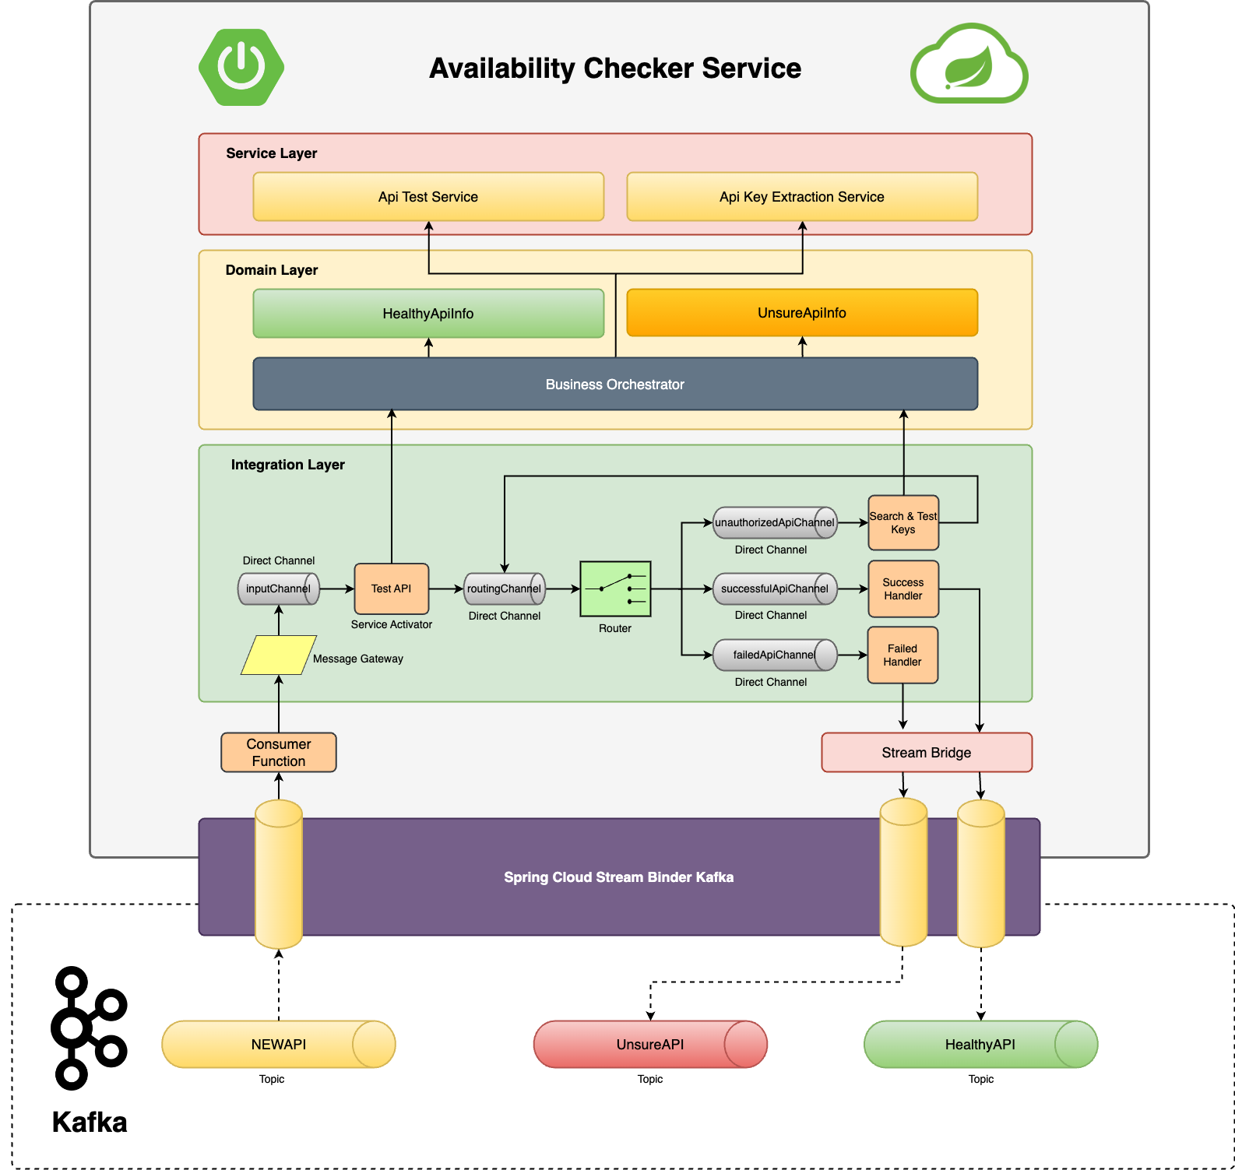
Application Architecture

Slide 6
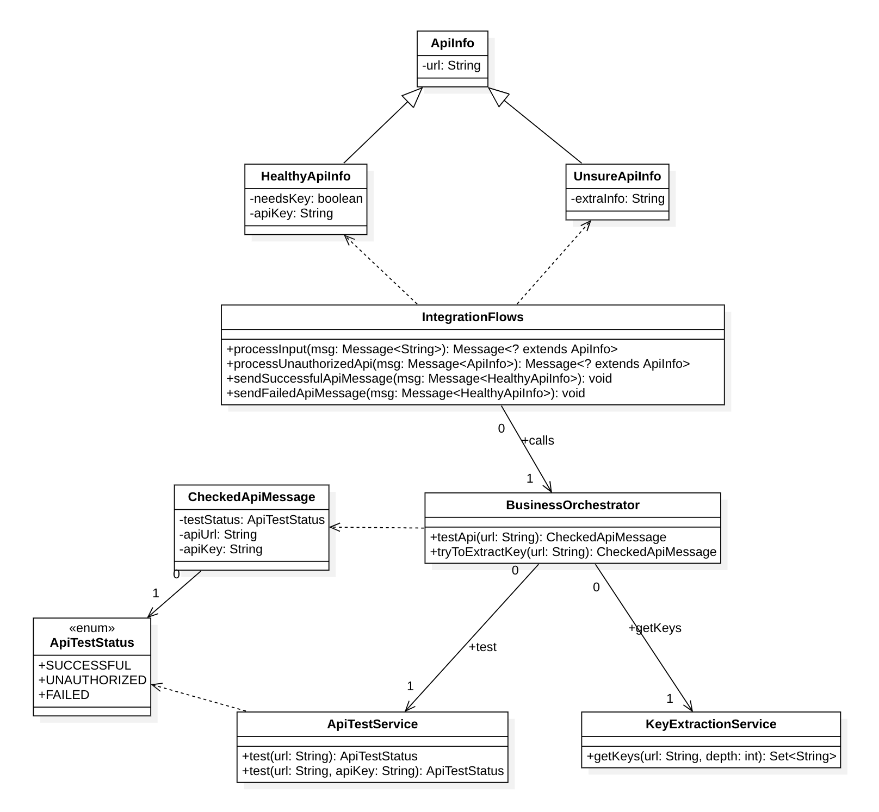
Class Diagram

Slide 7
Live Demo

Slide 8
Code snippets

Slide 9
Spring Cloud Config and Eureka Client
AvailabilityCheckerServiceApplication.java
@EnableDiscoveryClient
@SpringBootApplication
public class AvailabilityCheckerServiceApplication {
public static void main(String[] args) {
SpringApplication.run(
AvailabilityCheckerServiceApplication.class, args);
}
}
application.yml
eureka:
client:
service-url:
defaultZones: http://localhost:8761/eureka/
spring:
application:
name: AvailabilityCheckService
config:
import: configserver:http://localhost:8888
cloud:
config:
discovery:
enabled: true
name: Availability-Check-Service
pom.xml
<dependency>
<groupId>org.springframework.cloud</groupId>
<artifactId>spring-cloud-starter-config</artifactId>
</dependency>
<dependency>
<groupId>org.springframework.cloud</groupId>
<artifactId>spring-cloud-starter-netflix-eureka-client</artifactId>
</dependency>

Slide 10
Spring Cloud Stream Binder
A Spring Cloud Stream Binder is a component that implements communication with a specific message broker. For example, there is a RabbitMQ Binder, a Kafka Binder, and so on.
The Binder SPI consists of a number of interfaces, out-of-the-box utility classes and discovery strategies that provide a pluggable mechanism for connecting to external middleware. The key point of the SPI is the Binder interface which is a strategy for connecting inputs and outputs to external middleware.
Spring Cloud Stream relies on implementations of the Binder SPI to perform the task of connecting channels to message brokers.

Slide 11
Spring Cloud Stream Binder (cont.)
@Bean
public Consumer<Message<String>> inputDataConsumer() {
return msg -> {
log.info("Received input message: {}", msg);
messageGateway.sendToInputChannel(msg);
};
}
application.yml
spring:
cloud:
function:
definition: inputDataConsumer
stream:
bindings:
inputDataConsumer-in-0:
group: input-data-consumer
destination: ${app.kafka.input-destination}
pom.xml
<dependency>
<groupId>org.springframework.cloud</groupId>
<artifactId>spring-cloud-stream</artifactId>
</dependency>

Slide 12
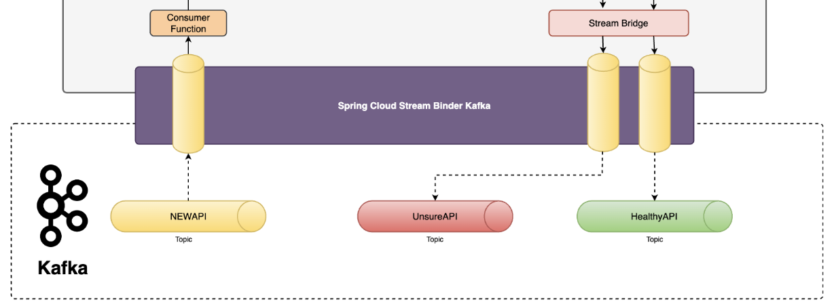
Spring Cloud Stream Binder Kafka

Slide 13
Spring Cloud Stream Binder Kafka (Cont.)
application.yml
spring:
cloud:
stream:
kafka:
binder:
brokers: localhost:9092
consumer-properties:
client.id: ACS
auto.offset.reset: earliest
required-acks: 1
bindings:
inputDataConsumer-in-0:
consumer:
ack-mode: manual
enable-dlq: true
dlq-name: DLQ.input-data
pom.xml
<dependency>
<groupId>org.springframework.cloud</groupId>
<artifactId>spring-cloud-stream</artifactId>
</dependency>
<dependency>
<groupId>org.springframework.cloud</groupId>
<artifactId>spring-cloud-stream-binder-kafka</artifactId>
</dependency>

Slide 14
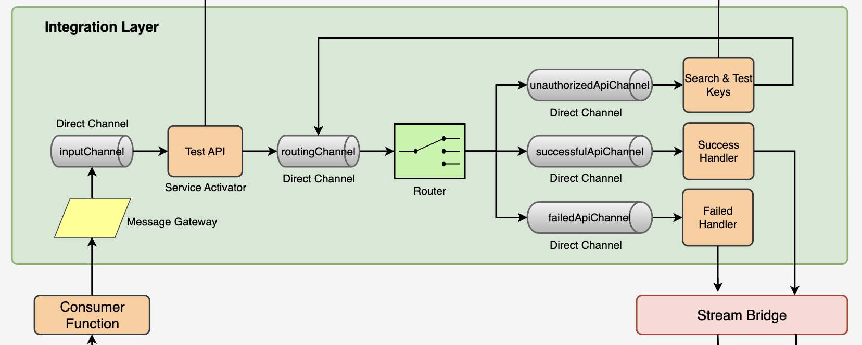
Integration Layer (Spring Integration)

Slide 15
Spring Integration Channels
@MessageEndpoint
public class Channels {
public static final String INPUT_CHANNEL = "inputChannel";
public static final String SUCCESSFUL_API_CHANNEL = "successfulApiChannel";
public static final String UNAUTHORIZED_API_CHANNEL = "unauthorizedApiChannel";
public static final String FAILED_API_CHANNEL = "failedApiChannel";
public static final String ROUTING_CHANNEL = "routingChannel";
@Bean(INPUT_CHANNEL)
public MessageChannel inputChannel() {
return new DirectChannel();
}
@MessagingGateway
public interface MessageGateway {
@Gateway(requestChannel = Channels.INPUT_CHANNEL)
void sendToInputChannel(Object object);
}

Slide 16
Routing Messages
@Bean
@ServiceActivator(inputChannel = Channels.ROUTING_CHANNEL)
public HeaderValueRouter router() {
HeaderValueRouter router = new HeaderValueRouter(HeaderUtils.SERVICE_LINE);
router.setChannelMapping(ServiceLine.SUCCESSFUL.getValue(), ServiceLine.SUCCESSFUL.getChannel());
router.setChannelMapping(ServiceLine.FAILED.getValue(), ServiceLine.FAILED.getChannel());
router.setChannelMapping(ServiceLine.UNAUTHORIZED.getValue(), ServiceLine.UNAUTHORIZED.getChannel());
return router;
}

Slide 17
Process Messages
@ServiceActivator(inputChannel = Channels.INPUT_CHANNEL, outputChannel = Channels.ROUTING_CHANNEL)
public Message<ApiInfo> processInput(Message<String> inputMessage) {
log.info("Processing input message: {}", inputMessage);
String url = inputMessage.getPayload();
ApiInfo payload = new ApiInfo(url);
Message<ApiInfo> outMessage = MessageBuilder
.withPayload(payload)
.copyHeaders(inputMessage.getHeaders())
.build();
ApiTestStatus testStatus = businessOrchestrator.testApi(url).getTestStatus();
ServiceLine serviceLine;
switch (testStatus) {
case SUCCESSFUL -> serviceLine = ServiceLine.SUCCESSFUL;
case UNAUTHORIZED -> serviceLine = ServiceLine.UNAUTHORIZED;
default -> serviceLine = ServiceLine.FAILED;
}
return MessageBuilder
.fromMessage(outMessage)
.setHeader(HeaderUtils.SERVICE_LINE, serviceLine.getValue()).build();
}

Slide 18
Process Messages (Cont.)
@ServiceActivator(inputChannel = Channels.UNAUTHORIZED_API_CHANNEL, outputChannel = Channels.ROUTING_CHANNEL)
public Message<ApiInfo> processUnauthorizedApi(Message<ApiInfo> inputMessage) {
log.info("Processing unauthorized api message: {}", inputMessage);
String url = inputMessage.getPayload().getUrl();
CheckedApiMessage checkedApiMessage = businessOrchestrator.tryToExtractKey(url);
ApiTestStatus testStatus = checkedApiMessage.getTestStatus();
ServiceLine serviceLine;
ApiInfo apiInfo;
if (Objects.requireNonNull(testStatus) == ApiTestStatus.SUCCESSFUL_AUTHORIZED) {
serviceLine = ServiceLine.SUCCESSFUL;
apiInfo = HealthyApiInfo.builder().url(url).apiKey(checkedApiMessage.getApiKey()).needsKey(true).build();
} else {
serviceLine = ServiceLine.FAILED;
apiInfo = UnsureApiInfo.builder()
.url(url)
.extraInfo("unauthorized")
.build();
}
return MessageBuilder
.withPayload(apiInfo)
.copyHeaders(inputMessage.getHeaders())
.setHeader(HeaderUtils.SERVICE_LINE, serviceLine.getValue())
.build();
}

Slide 19
Process Messages (Cont.)
@ServiceActivator(inputChannel = Channels.SUCCESSFUL_API_CHANNEL)
public void sendSuccessfulApiMessage(Message<HealthyApiInfo> message) {
streamBridge.send(integrationProperties.getSuccessDestination(), message);
acknowledge(message);
log.info("Sent message to {}. Message = {}", integrationProperties.getSuccessDestination(), message);
}
@ServiceActivator(inputChannel = Channels.FAILED_API_CHANNEL)
public void sendFailedApiMessage(Message<UnsureApiInfo> message) {
streamBridge.send(integrationProperties.getFailedDestination(), message);
acknowledge(message);
log.info("Sent message to {}. Message = {}", integrationProperties.getFailedDestination(), message);
}
private void acknowledge(Message<?> message) {
Acknowledgment acknowledgment = message.getHeaders().get(KafkaHeaders.ACKNOWLEDGMENT, Acknowledgment.class);
if (acknowledgment != null) {
acknowledgment.acknowledge();
log.debug("Acknowledged message: {}", message);
}
}

Slide 20
API Availability Test
private ApiTestStatus headForStatus(String url, Optional<String> apiKeyOpt) throws Exception {
return exchangeForStatus(url, HttpMethod.HEAD, apiKeyOpt);
}
private ApiTestStatus getForStatus(String url, Optional<String> apiKeyOpt) throws Exception {
return exchangeForStatus(url, HttpMethod.GET, apiKeyOpt);
}
private ApiTestStatus exchangeForStatus(String url, HttpMethod method, Optional<String> apiKeyOpt) throws Exception {
HttpHeaders httpHeaders = new HttpHeaders();
apiKeyOpt.ifPresent(apiKey -> httpHeaders.add(HttpHeaders.AUTHORIZATION, "Basic " + apiKey));
HttpEntity<String> request = new HttpEntity<>(httpHeaders);
ResponseEntity<String> response = restOperations.exchange(url, method, request, String.class);
HttpStatusCode statusCode = response.getStatusCode();
log.info("Method = {}, responseStatus = {}, url = {}. ", method, statusCode, url);
if (apiTestProperties.getSuccessfulHttpStatuses().contains(statusCode.value())) {
return ApiTestStatus.SUCCESSFUL;
} else if (apiTestProperties.getUnauthorizedHttpStatuses().contains(statusCode.value())) {
return ApiTestStatus.UNAUTHORIZED;
}
return ApiTestStatus.FAILED;
}

Slide 21
API Key Extraction
public Set<String> getKeys(String url, int depth) {
Set<String> apiKeys = new HashSet<>();
if (depth <= 0) {
return apiKeys;
}
String domain = UrlUtils.extractDomain(url);
try {
Document doc = Jsoup.connect(url).get();
apiKeys.addAll(getKeys(doc));
Set<String> testUrls = extractUrls(domain, doc);
depth--;
for (String testUrl : testUrls) {
apiKeys.addAll(getKeys(testUrl, depth));
}
} catch (Exception e) {
log.warn("error while extracting key for {} error message: {}, depth: {}", url, e.getMessage(), depth);
}
return apiKeys;
}

Slide 22
API Key Extraction (Cont.)
private Set<String> extractUrls(String baseDomain, Document document) {
Set<String> urls = new HashSet<>();
Elements linkElements = document.select("a");
for (Element linkElement : linkElements) {
String pathOrUrl = linkElement.attr("href");
String testUrl;
if (pathOrUrl.trim().startsWith("/")) {
testUrl = baseDomain + pathOrUrl;
} else {
testUrl = pathOrUrl;
}
urls.add(testUrl);
}
return urls;
}

Slide 23
API Key Extraction (Cont.)
private static ArrayList<Element> getPotentialKeyPlaces(Document document) {
ArrayList<Element> apiKeys = new ArrayList<>();
// Scenario 1: Add all input elements with a name that matches "api-key*" or any variations.
apiKeys.addAll(document.select("input[name^=api-key], input[name^=api_key]"));
apiKeys.addAll(document.select("input[name=api-key], input[name=api_key]"));
// Scenario 2: Add all elements with a class that contains "api-key" or any variations.
apiKeys.addAll(document.select("[class~=.*\\bapi-key\\b.*], [class~=.*\\bapi_key\\b.*]"));
// Scenario 3: Add all elements with a data-* attribute that contains "api-key" or any variations.
apiKeys.addAll(document.select("[data-*~=.*\\bapi-key\\b.*], [data-*~=.*\\bapi_key\\b.*]"));
// Scenario 4: Add all elements that contain the text "api-key" or any variations.
apiKeys.addAll(document.select(":containsOwn(api-key), :containsOwn(api_key)"));
// Scenario 5: Add all elements with ID containing "api-key" or any variations.
apiKeys.addAll(document.select("[id~=.*\\bapi-key\\b.*], [id~=.*\\bapi_key\\b.*]"));
// Scenario 6: Add all elements with a specific attribute value that matches any variations of "api-key".
apiKeys.addAll(document.select("[data-custom-attribute~=^api-key|^api_key|^api-key-id|^api-key-secret|^api-key-token|^api-key-password|^api-key-auth|^api-key-bearer|^api-key-consumer|^api-key-client|^api-key-developer|^api-key-partner|^api-key-vendor|^api-key-public|^api-key-private|^api-key-test|^api-key-prod|^api-key-dev|^api-key-staging|^api-key-production|^api-key-live|^api-key-sandbox|^api-key-sandbox-id|^api-key-sandbox-secret|^api-key-sandbox-token|^api-key-sandbox-password|^api-key-sandbox-auth|^api-key-sandbox-bearer|^api-key-sandbox-consumer|^api-key-sandbox-client|^api-key-sandbox-developer|^api-key-sandbox-partner|^api-key-sandbox-vendor|^api-key-sandbox-public|^api-key-sandbox-private|^api-key-sandbox-test|^api-key-sandbox-prod|^api-key-sandbox-dev|^api-key-sandbox-staging|^api-key-sandbox-production|^api-key-sandbox-live]"));
// Scenario 7: Add all elements inside a specific parent element with class "api-key" or any variations.
apiKeys.addAll(document.select("parent-selector > [class~=.*\\bapi-key\\b.*], parent-selector > [class~=.*\\bapi_key\\b.*]"));
// Scenario 8: Add all elements with a specific attribute name that contains "api-key" or any variations.
apiKeys.addAll(document.select("[data-*=.*\\bapi-key\\b.*], [data-*=.*\\bapi_key\\b.*]"));
return apiKeys;
}

Slide 24
API Key Extraction (Cont.)
private Set<String> getKeys(Document document) {
ArrayList<Element> potentialKeyElements = getPotentialKeyPlaces(document);
Set<String> apiKeys = potentialKeyElements.stream()
.map(Element::text)
.filter(KeyExtraction::isPotentialApiKey)
.collect(Collectors.toSet());
return apiKeys;
}

